Slide 1
Workshop
Introduction to Python

Slide 2
Rob Carrington
4 years as a Python developer
Worked in FinTech (@Q2eBanking)

Slide 3



Q2

Slide 4

Automation
Python for

Slide 5

Web Development
Python for

Slide 6
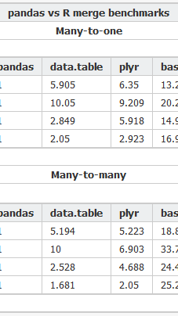
Data Analysis
Python for

Slide 7
Goals? Background?
how About you

Slide 8
Workshop format

Slide 9
Workshop format

Slide 10

Workshop format
15 minute for lesson
10 minutes for exercise
5-10 minutes to review
rinse and repeat

Slide 11

ME
What’s in it for

Slide 12
Csv
Analysis of a

Slide 13
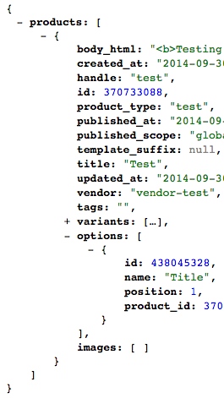
Apis
using data from

Slide 14
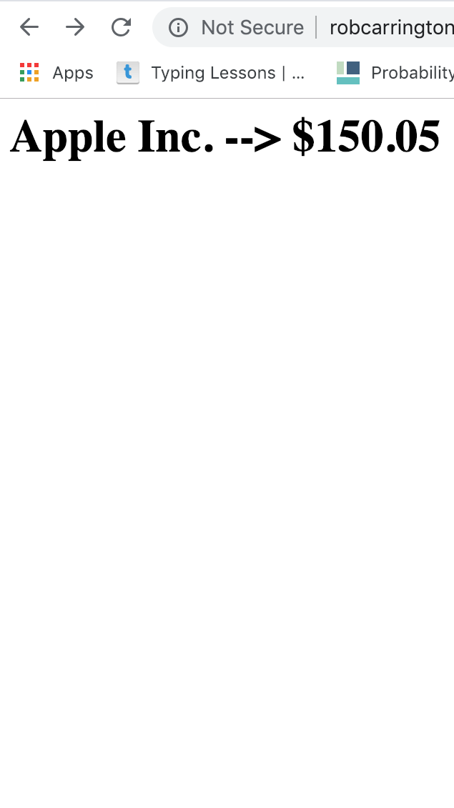
Website
Creating a dynamic

Slide 15
Fundamentals

Slide 16
How to think about Python
You are giving orders to your computer
Each order is called a “statement”

Slide 17
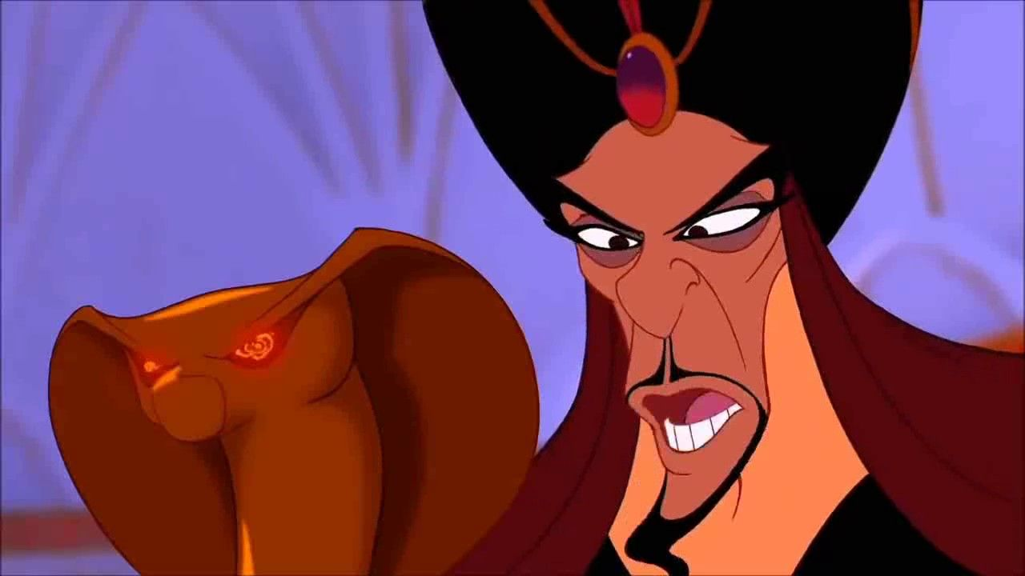
You
Python

Slide 18

Your Computer

Slide 19
ASSIgnment Statement
English:
remember “fav_number” means 3

Slide 20
Assignment Statement
fav_number = 3

Slide 21
ASSIgnment Statement
English translation:
remember “fav_number” means 3
variable

Slide 22
Rules for Variables
Must start with a letter or underscore
Cannot start with a number
Only letters, numbers and underscores allowed
Variable names are case-sensitive

Slide 23
ExpressionS
An expression is a piece of a statement
Noun without a verb

Slide 24

Python works Just like your calculator
If you enter an expression like 7+9, Python will boil that down to a single value like 16.

Slide 25
Why Do I care?
Compare to Excel formulas
Can find compound interest, etc

Slide 26
Old Friends
Integers (called “int”)
Decimals (called “float”)

Slide 27
Old Friends
Addition (+)
Multiplication (*)
Division (/)
Exponents (**)

Slide 28
A New Friend
Modulo (%)
Finds the remainder

Slide 29
Concepts covered so Far
Statement
Expression
Variable
Int, Float

Slide 30
Exercises

Slide 31
Strings
Surrounded by quotes (single/double)
Treated like meaningless symbols

Slide 32
String Example
a = “hello world!”

Slide 33
Print STATEMENT
English:
Print “hello world” on the screen

Slide 34
print Statement
print(“hello world!”)

Slide 35
print Statement
print(“hello world!”)
function

Slide 36
F-strings
fav_number = 3
print(“f{fav_number} is ok”)

Slide 37
works like your calculator
True in general, not just for numbers. “Hot” + “dog” will be evaluated as “Hotdog”

Slide 38
Values: What kinds are there?
Int
Float
String
?

Slide 39
Concepts covered so Far
Statement (print, assignment)
Variable
Expression
Data Types (int, float, str)

Slide 40
Exercises

Slide 41
The READ-eval-print-loop (REPL)
Talk directly to the Python interpreter
Executes one statement at a time

Slide 42
Values: What kinds are there?
Int
Float
String
?

Slide 43
Booleans
100 > 0
“this str” == “that str”

Slide 44
Booleans
100 > 0
“this str” == “that str”
True
False

Slide 45
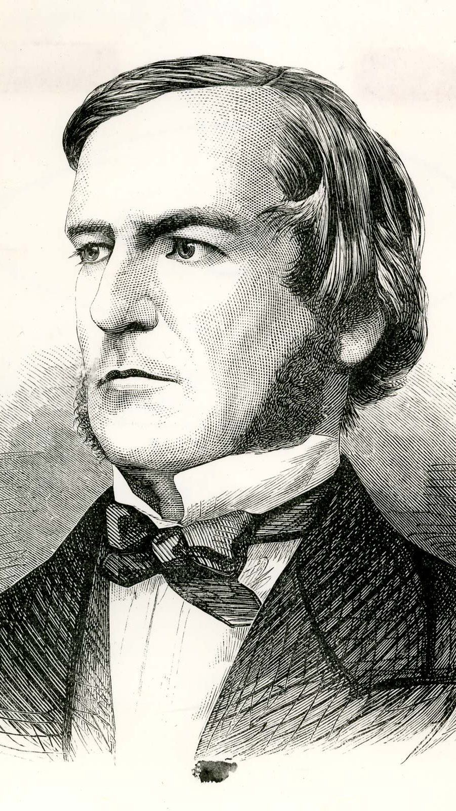
“universal laws of thought which are …mathematical as to their form”
George Boole

Slide 46
Boolean Operators?
True + False
True * False
True / True

Slide 47
Boolean Operators?
True + False
True * False
True / True

Slide 48
Boolean Operators
or
and
not

Slide 49
Boolean Operators
True or False
True and False
not True

Slide 50
Boolean Operators
True or False
True and False
not True
True

Slide 51
Boolean Operators
True or False
True and False
not True
True
False

Slide 52
Boolean Operators
True or False
True and False
not True
True
False
False

Slide 53
Values: What kinds ARE THERE?
Int
Float
String
Bool

Slide 54
Mixing data types
1 + 7.2 = 8.2

Slide 55
Mixing data types
1 + 7.2 = 8.2
1 + “7.2” = error

Slide 56
Mixing data types
1 + 7.2 = 8.2
1 + int(“7.2”) = 8.2

Slide 57
Casting between Data types
int()
float()
str()

Slide 58
Exercises

Slide 59
List
Ordered
No set length or data type

Slide 60
List: Basic usage
my_list = [1, “two”, 3.0]

Slide 61
List: Basic usage
my_list.append(4)

Slide 62
List: Basic usage
my_list.append(4)
Method

Slide 63
Functions vs methods, briefly
reverse(“racecar”)
“race car”.split()

Slide 64
Functions vs methods, briefly
Both perform an “action”
Difference: how data is passed in

Slide 65
Functions and methods, briefly
Data passed through parentheses
reverse(“racecar”)
“race car”.split()

Slide 66
Functions and methods, briefly
Data passed through parentheses
reverse(“racecar”)
Data given by context of method
“race car”.split()

Slide 67
List: Basic usage
last_item = my_list.pop()

Slide 68
Indexing Syntax
English:
get the first element in my_list

Slide 69
Indexing Syntax
my_list[0]

Slide 70
Indexing Syntax
my_list[0]
Beware zero-indexing!

Slide 71
Indexing Syntax
English translation:
get the seventh element in my_list

Slide 72
Indexing Syntax
my_list[6]

Slide 73
Indexing Syntax
English:
get the last element in my_list

Slide 74
Indexing Syntax
my_list[-1]

Slide 75
Slice Syntax
English:
get the first four elements of my_list

Slide 76
SLICE Syntax
my_string[0:4]

Slide 77
SLICE Syntax
my_string[0:4]
not included!

Slide 78
SLICE Syntax
my_string[:3]

Slide 79
Slice Syntax
English translation:
get all the elements up to the third

Slide 80
SLICE Syntax
my_string[2:]

Slide 81
Slice Syntax
English translation:
get all the elements from the third until the end

Slide 82
StringS: Kind of like a list!
Same index and slice syntax!

Slide 83
StringS: but Also… Not a list
Cannot add or remove characters

Slide 84
Concepts covered so Far
Boolean values (True/False)
Boolean operators
Casting data types
How to use a list

Slide 85
Exercises

Slide 86
Concepts covered so Far
Boolean values (True/False)
Boolean operators
Casting data types
How to use a list

Slide 87
What’s missing?

Slide 88
Flow Diagram
Start
Finish

Slide 89


Slide 90
Conditional Statements
Directs route taken by program
Hinges on Boolean expressions

Slide 91
if Statement
if condition_is_true:
print(“extra code runs!”)

Slide 92
Flow Diagram
Extra
Yes
Start
If
No
Finish

Slide 93
if-Else Statement
if condition_is_true:
print(“path #1 runs”)
else:
print(“path #2 runs”)

Slide 94
Flow Diagram
Path 1
Yes
Start
If
Finish
No
Path 2

Slide 95
if-elif-Else Statement
if condition_is_true:
print(“path #1 runs”)
elif second_condition_is_true:
print(“path #2 runs”)
else:
print(“path #3 runs”)

Slide 96
Flow Diagram

Slide 97
Flow Diagram

Slide 98
Conditional Statements
Directs route taken by program
Hinges on Boolean expressions

Slide 99
Exercises

Slide 100
For-Loops
Repeats a chunk of code
Hands in different item each time

Slide 101
For-loops
pets = [“dog”, “cat”, “fish”]
for pet in pets:
print(pet)

Slide 102
For-loops
pets = [“dog”, “cat”, “fish”]
for pet in pets:
if pet == “dog”:
print(“Man’s best friend!”)
else:
print(“whatever”)

Slide 103
For-Loops
Repeats a chunk of code
Hands in different item each time

Slide 104
Exercises

Slide 105
Function
Block of reusable code
Black box that performs one task

Slide 106
Function
def my_function(name):
print(“hello {name}!”)

Slide 107
Function
def my_function(name):
return “hello {name}!”

Slide 108
Function
def my_function(name):
if name == “rob”:
return “Man’s best friend!”)
else:
return “whatever”

Slide 109
Function
Block of reusable code
Black box that performs one task

Slide 110
Exercises

Slide 111
Values: what kinds are there?
data types: int, float, string, bool
lists of the above

Slide 112
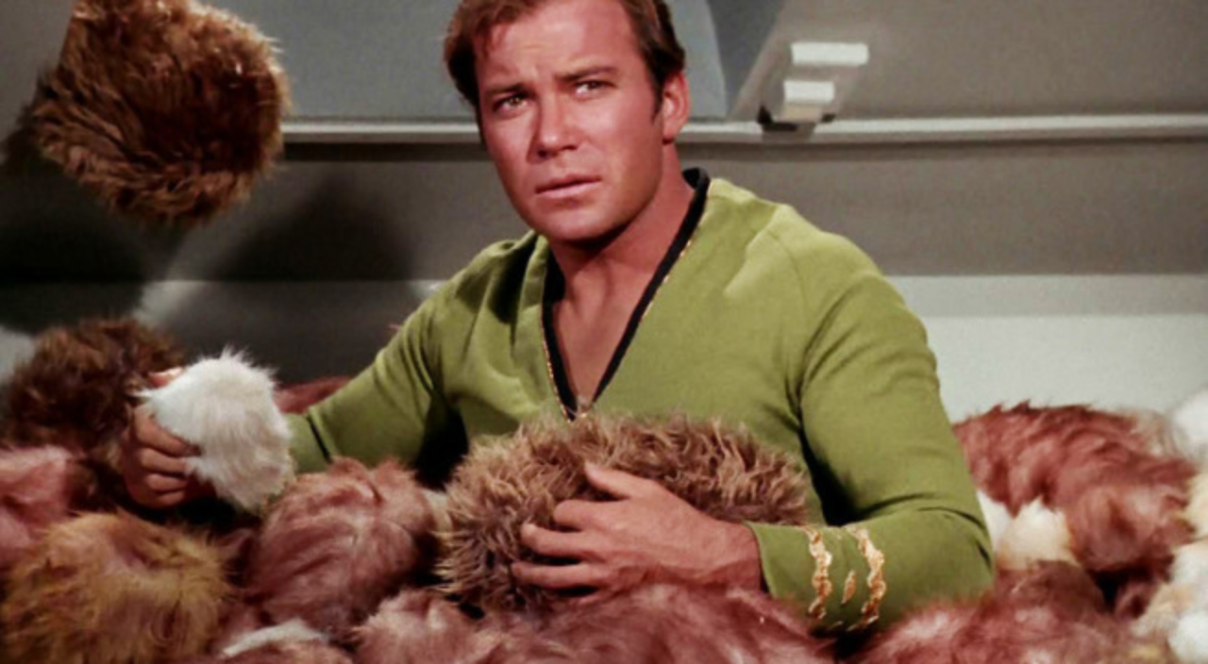
Trouble with Lists
Hard to manage lots of data

Slide 113
Trouble with Lists
Was it my_list[8] or my_list[9]?
Hard to manage lots of data

Slide 114


Slide 115
Dictionary
Stores a value under a name (“key”)
You can fetch value later by key

Slide 116
Dictionary
my_dict = { “key”: “value” }

Slide 117
Dictionary
my_dict = {“key1”: “value1”,
“key2”: “value2”}

Slide 118
Dictionary
my_dict[“key1] = “new_value”

Slide 119
Dictionary
for key in my_dict:
print(f“look at this {key}!”)

Slide 120
Dictionary
for value in my_dict.values():
print(f“look at this {value}”)

Slide 121
Dictionary
for key, value in my_dict.items():
print(f“look at this {key}!”)
print(f“look at this {value}”)

Slide 122
Exercises

Slide 123
Class
Way of bundling data and code
Core of OOP (object oriented)

Slide 124
Class
class Person():
def __init__(self, name, age):
self.name = name
self.age = age

Slide 125
Class
class Person():
…
def say_hello(self):
print(f“hello, {self.name}!”)

Slide 126
Class vs object
class is a “blueprint” with empty slots
object is one occurrence, slots filled

Slide 127
Class
rob = Person(“Rob”, 29)
rob.name
>>> “Rob”

Slide 128
Class
rob = Person(“Rob”, 29)
rob.say_hello()
>>> “Hello, Rob!”

Slide 129
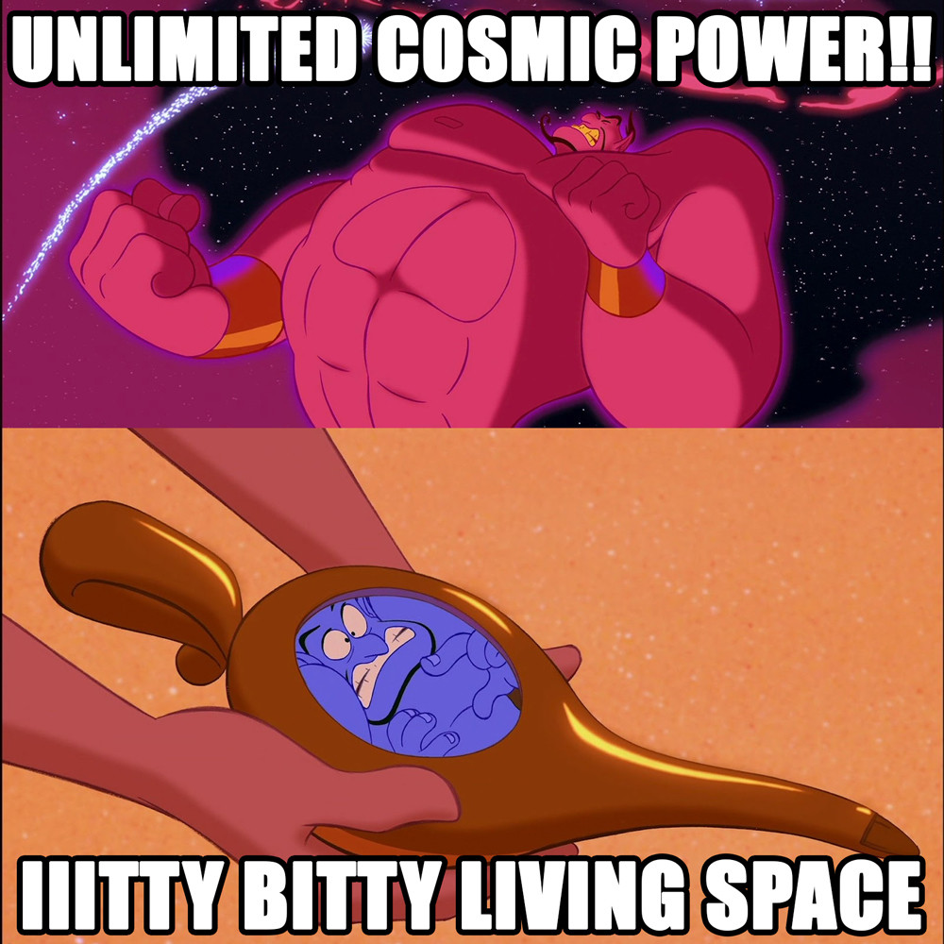

Slide 130
Importing packages
Use pre-made classes and functions
Save a ton of time!

Slide 131


Slide 132
Importing packages
Core Libraries: “batteries included”
3rd Party: have to be downloaded

Slide 133
Importing packages
import pandas
from pandas import read_csv

Slide 134
Pandas
short for “panel data”
essential for Python data science

Slide 135
Pandas
Dataframe class does A LOT
columns in a dataframe are Series

Slide 136
Concepts covered so Far
Dictionary
Class
Packages
Pandas library

Slide 137
Exercises

Slide 138
Csv
Analysis of a

Slide 139


Slide 140
Website
Creating a dynamic

Slide 141
API
Application Programming Interface
no visuals — built for robots

Slide 142
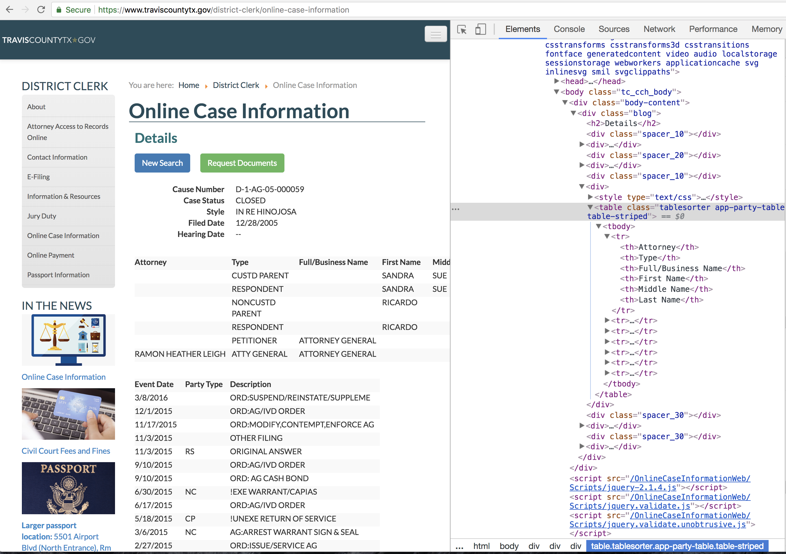
Notes:
To make this work for a computer program.
For the purposes of this talk, I’ll define webscraping as automating the process of taking text from a webpage, cleaning it up and inserting it into a csv.
Websites are like a colorful, interactive movie. But what really gets sent over the internet is more like a script, for that movie.

Slide 143

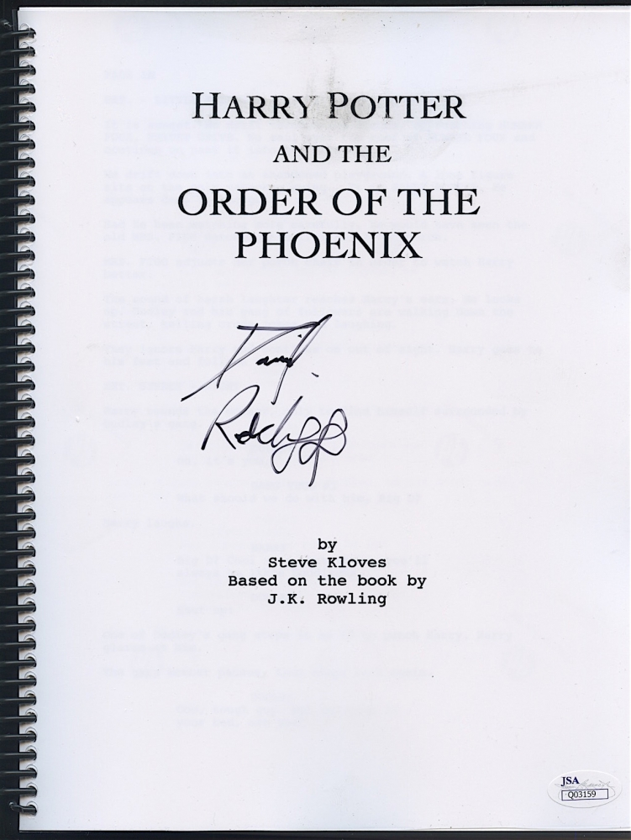
HTML
Notes:
To make this work for a computer program.
Websites are like a colorful, interactive movie. But what really gets sent over the internet is more like a script, for that movie.

Slide 144

No thanks
Notes:
Make your code as simple as possible. Instead of having a whole web page with buttons and input fields, an API

Slide 145
Json
Simple format for sending data
Turns into a Python dictionary!

Slide 146
Json
{
"name": “John Smith",
"address": {
"street": "21 2nd Street",
"city": "New York” }
}

Slide 147
API
Going to use IEXTrading.com
No account/password needed!

Slide 148
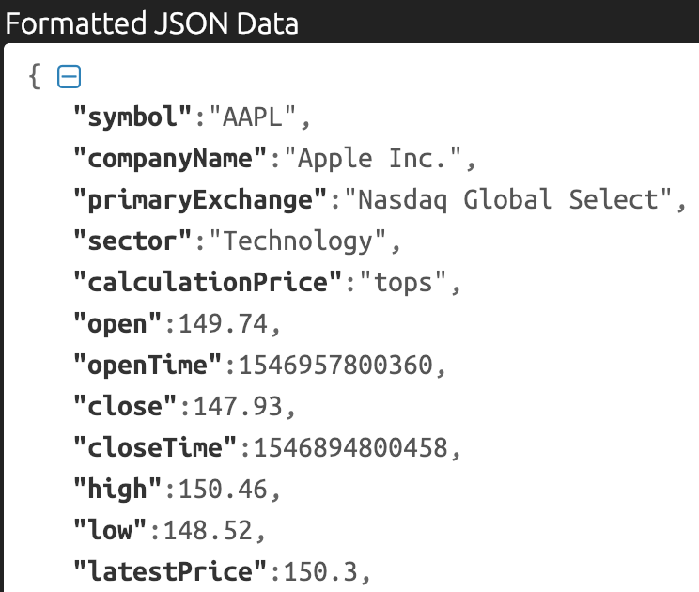

Slide 149
URLLIB
Core library for using the web
Just grabs text, unlike browser

Slide 150
Flask
Lightweight server framework
Very popular for APIs, simple sites

Slide 151
Decorators
@this_is_a_decorator
def my_function(name):
print(“hello {name}!”)

Slide 152
Decorators
Used to modify a function
Attaches function to a URL in Flask

Slide 153
Decorators
@app.route('/')
def hello():
return ‘<h1>hello world!</h1>’

Slide 154
Python Files
Execute Python all at once
Used by engineers

Slide 155
File Exercise

Slide 156
Internet
Deploying your app to the

Slide 157
Python anywhere
Easiest way to deploy
Free to create an account

